Slide 1
React- Redux Laiba Imran

Slide 2
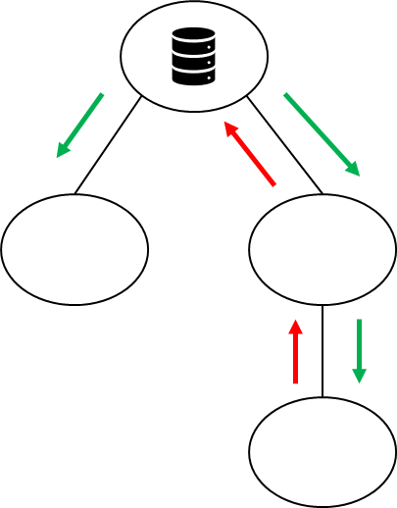
Basic State Management in React
States stored in root component
Parent passes data down to children as properties
Parent also passes callback functions to children as properties, and children can use those callbacks.

Slide 3
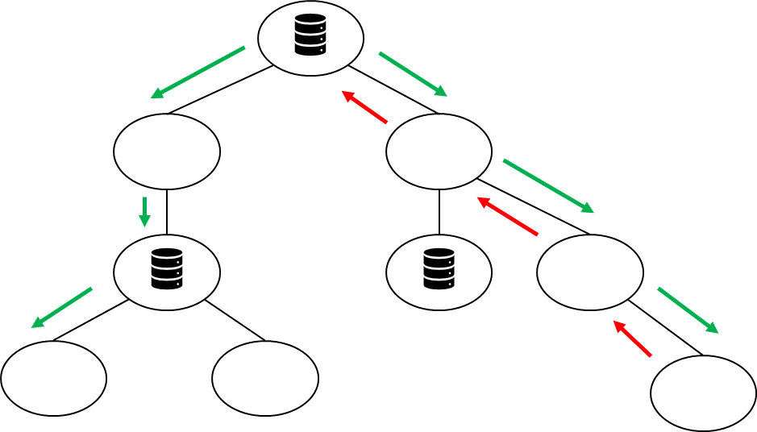
State Management Can Get Difficult and Messy

Slide 4
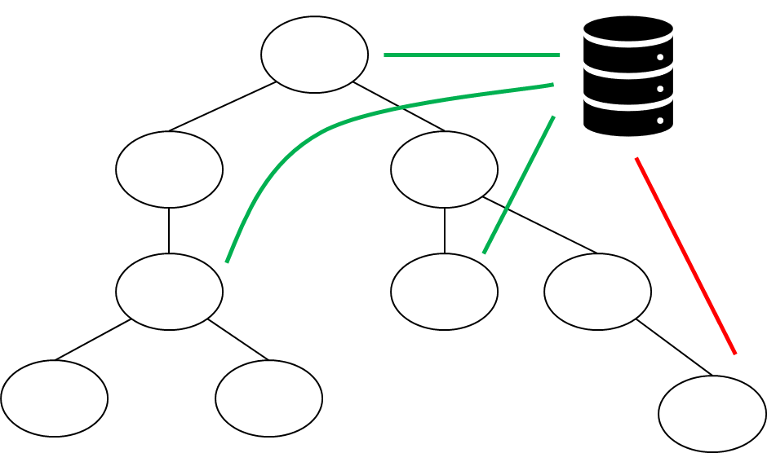
Store States in One Place

Slide 5
State Management Solutions
React Context API
Zustand
Redux
More mature and performant
More features and tool support

Slide 6
React Redux
Redux is a state management library. Think of it like a "central database" that your entire app can access to store and retrieve data.
Instead of each component in a React app managing its own state, Redux holds all the state in one place (the store), so different parts of the app can share and update this state consistently.

Slide 7
How the Redux Works
Store: The central place where the entire state of the application is stored. Only one store is allowed per Redux application.
State: The current data of your app.
Actions: Plain JavaScript objects that represent events or intentions to change the state. Each action has a type (a string describing the action) and optionally some data (payload) to update the state.
Reducers: Pure functions that specify how the state changes in response to actions. A reducer takes the current state and an action as arguments and returns the new state.
Dispatch: A method used to send an action to the Redux store, triggering the store to run the reducers and update the state accordingly.

Slide 8
Resources
Go over
https://www.freecodecamp.org/news/redux-and-redux-toolkit-for-beginners/
https://react-redux.js.org/introduction/getting-started
https://www.mitrais.com/news-updates/the-easy-way-to-use-redux-toolkit-in-react/

